Slide 1

Project Structure and Organization

Slide 2

Goals
Notes:
Make sure we’re on the right track.
Not insulting anyone’s intelligence, just want to make sure we’re all “singing from the same sheet”

Slide 3

Agenda/Topics Covered
Sample Project
Clean Architecture and Current Infinity Apps
Moving Away From Controllers (REPR)
Vertical Slice Architecture
Domain-Driven Design
CQRS
Event Sourcing

Slide 4

Demo

Slide 5
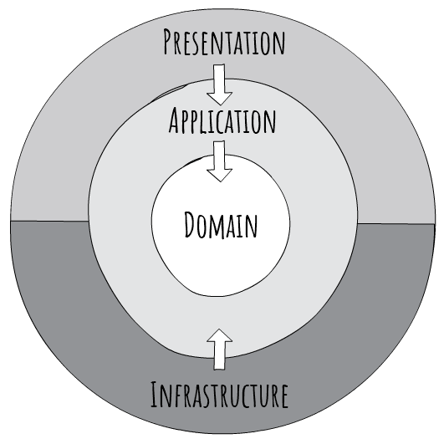
Clean Architecture

Slide 6
Problems with this
Violates SRP
Large, Bloated Controllers
Duplicate Business Rules/Validation
Poorly Modeled Domain
Invalid Domain Object States
Painful Unit Testing
Notes:
Large, Bloated Controllers: Controllers are tightly coupled together in a single class. How do we know for sure a change to one endpoint didn’t affect another?
Duplicate Business Rules/Validation: Every “service” has to validate that a duplicate task doesn’t exist. That “status” is valid, etc. These Business Rules are not encapsulated anywhere.
Poorly Modeled Domain: Again, our anemic domain is not “expressive” and gives no indication on what the intent of this system is.
Invalid Domain Object States: As soon as I new up that object I have an invalid state and it’s up to the developer to remember everything that is needed to bring that into a valid state. Lots of room for bugs and errors
Painful Unit Testing: Unit tests should be small and test one thing. Every Unit test I have to mock out all my dependencies just to hit one thing. This results in very large and unreadable unit tests.
*** A lot of the refactoring I’m going to show aims to solve these issues.

Slide 7
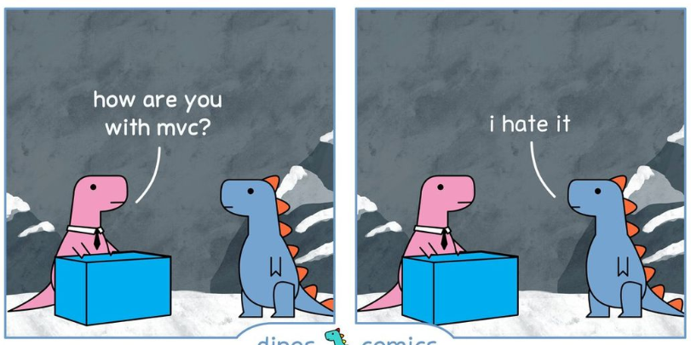
Moving Away From Controllers MVC Controllers are Dinosaurs - Embrace API Endpoints | Blog (ardalis.com)

Slide 8

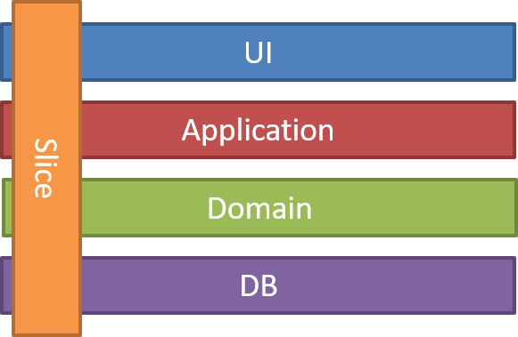

“One Endpoint One File”
Fits Nicely with Vertical Slice Architecture
REPR Pattern
(Request-Endpoint-Response)

Slide 9
Demo

Slide 10


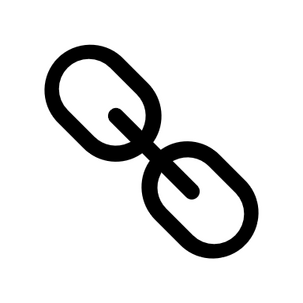

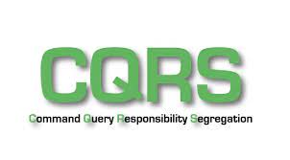
Benefits
Models/Controllers Folders
Less Dependencies (Only What YOU Need)
Coupling Around Endpoint VS Entire Resource
Sets Us Up For CQRS
No Real Need for a Mediator
Notes:
CQRS: Really useful if we decide to do Event Sourcing and want to read from a Materialized View

Slide 11
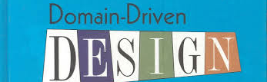
Domain Driven Design
Notes:
DDD is a HUGE topic. What I’m focusing on are two major takeaways:
Modeling our Core Domain after the Business and encapsulating those rules within those domain entities
Using that Domain to express the intent of our system

Slide 12
Demo

Slide 13
Benefits
Thinner Application Layer
Encapsulated Business Rules
Entities Will Always be Valid
Core is More “Expressive”
Better Unit Testing
Notes:
Thinner Application Layer: I like Steve Smith’s naming convention of “Use Cases” over “Application Layer”. Now we can actually use this layer for what it’s intended for, and that’s for our application or aggregate services – complex operations that span many aggregates.
Encapsulated Business Rules: Both the “Update” and “MassUpdate” methods were forced to adhere to the “ToDoItems” business rules when updating.
Entities will always be valid: The state of a domain object will never be in an invalid state.
Core is More “Expressive”: Again, much easier to understand what our system is trying to achieve when we model our code after the language used by the business
Painful Unit Testing: Unit testing is so much easier. We don’t have to mock anything out. I think Moq is a great library as it allowed us to test more things without worrying about their dependencies, but I think it’s greatly misused.

Slide 14
A Note On CQRS & Event Sourcing
Notes:
For the Query Endpoints, we can swap out retrieving from a repository and just as easily reach out to a materialized view. This’ll be especially handy if we decide to do Event Sourcing, as I’m guessing at some point we’ll have to aggregate a whole bunch of data to display to the user and we can then optimize that query.

Slide 15

That’s it!

